Slide 1


OR635 Term Project: Cyber Attack Affect on Port Miami Ship to Shore Crane Container Processing
Anthony Crespo

Slide 2
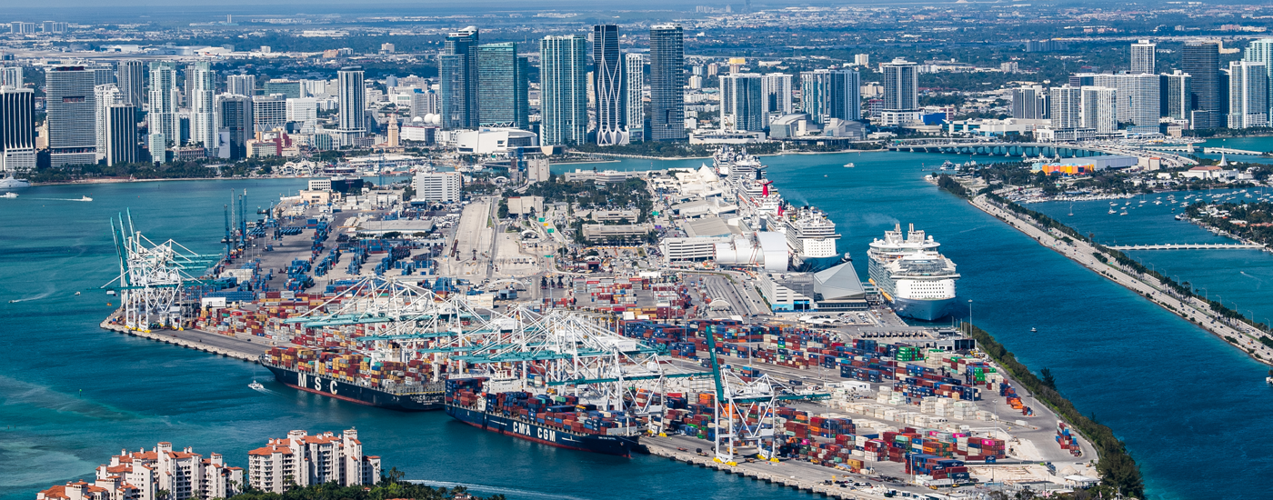
Presentation Agenda
Goal and Definitions
Data and Methodology
Models
Results and Topics for further consideration
Questions

Slide 3
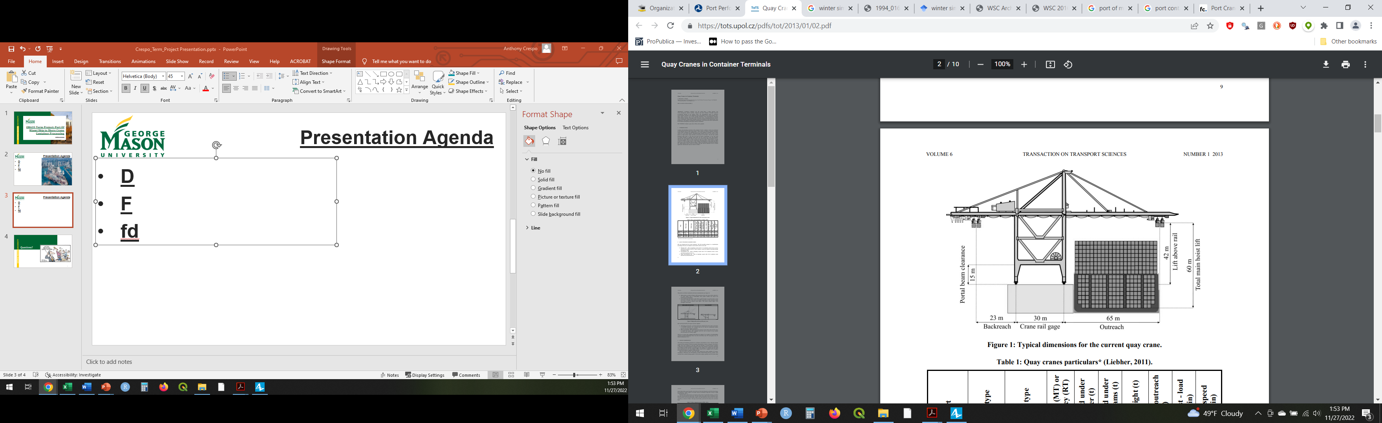
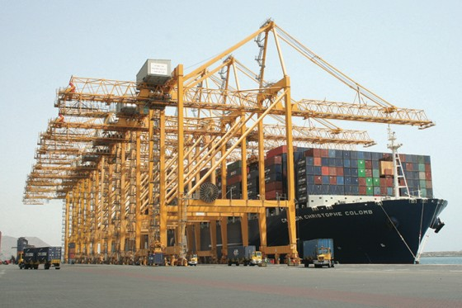
Study Goal and Definitions
Modeling a cyber attack on cranes at Port Miami and its affect on cargo processing.
Twenty Foot Equivalent Unit (TEU): Industry standard to measure shipping container, cargo ship capacity, and port through put.
Movement: Completed action of a crane picking up a container from the ship, traversing it back to the quay, and lowering it onto an awaiting chassis or the ground.

Slide 4
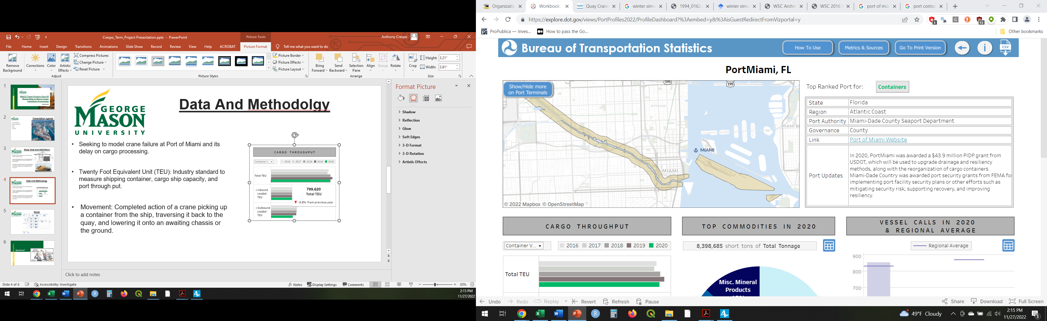
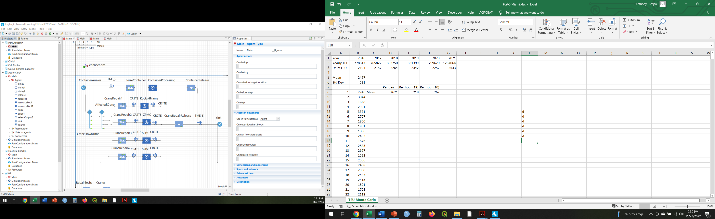
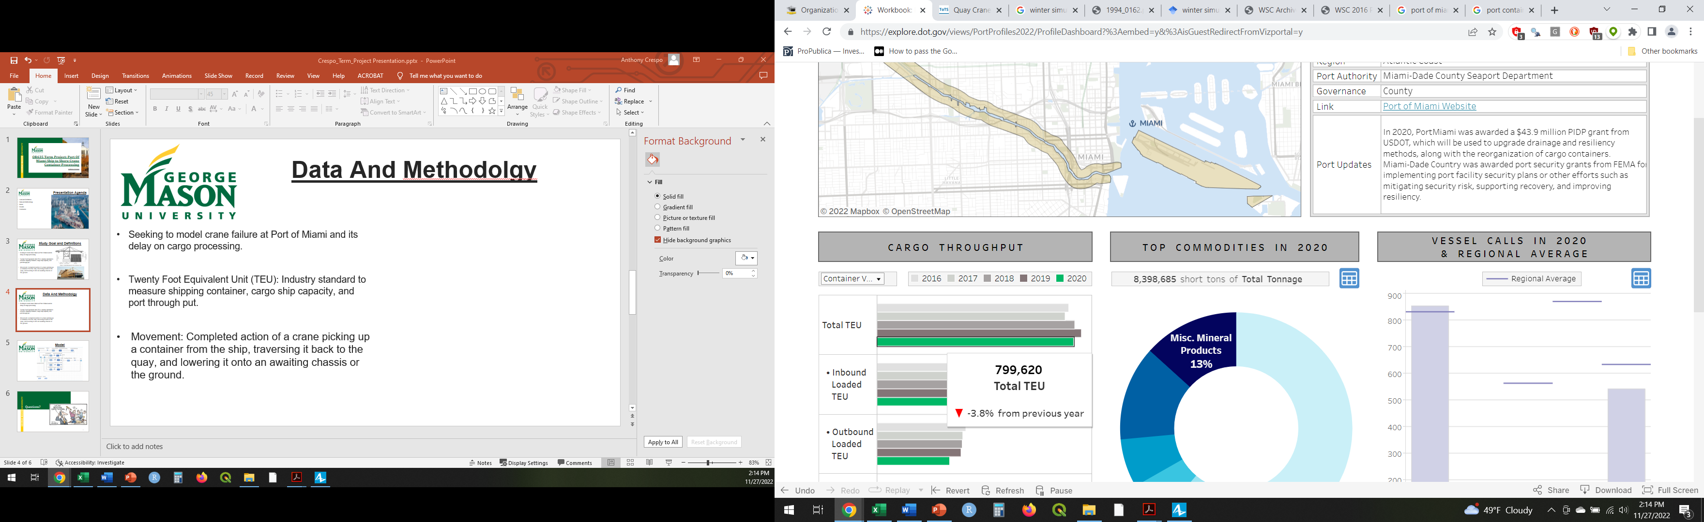
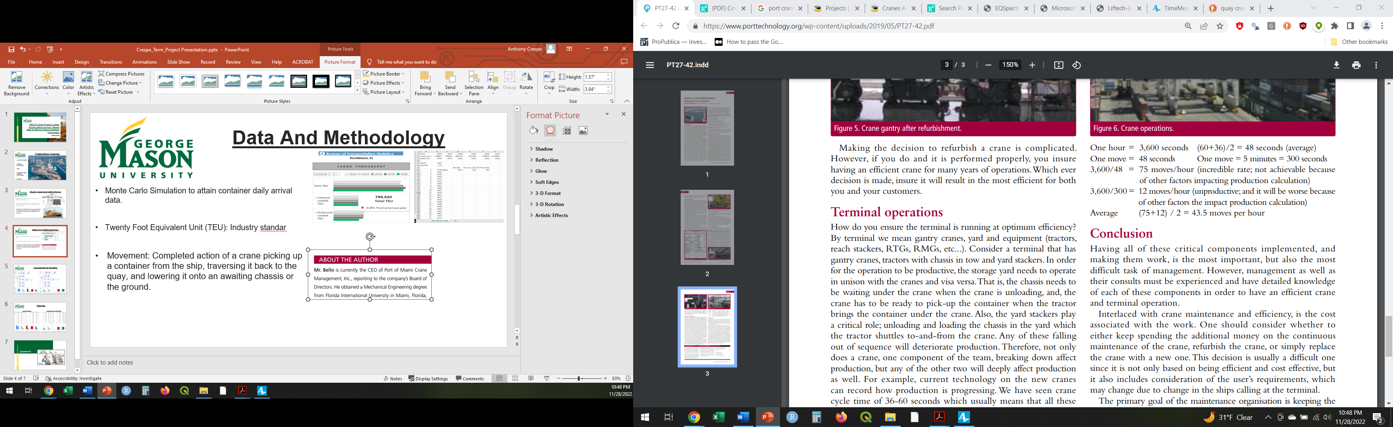
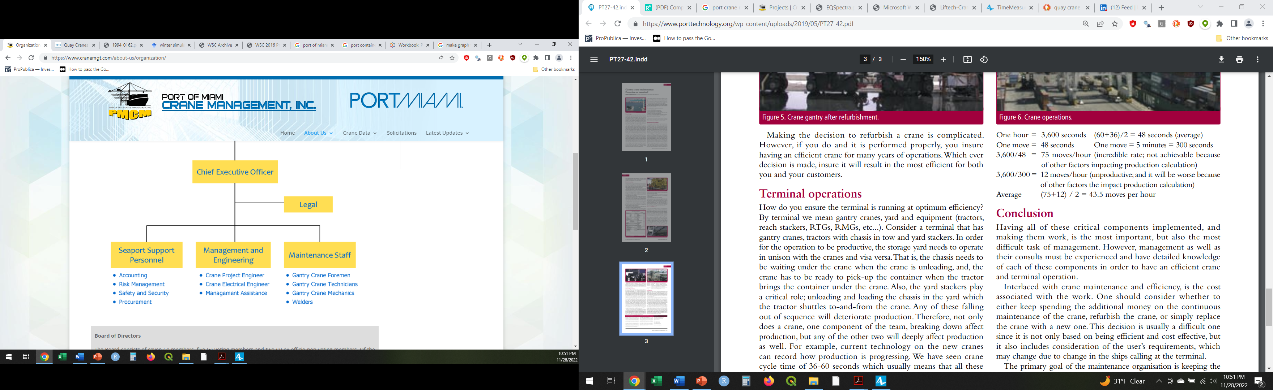
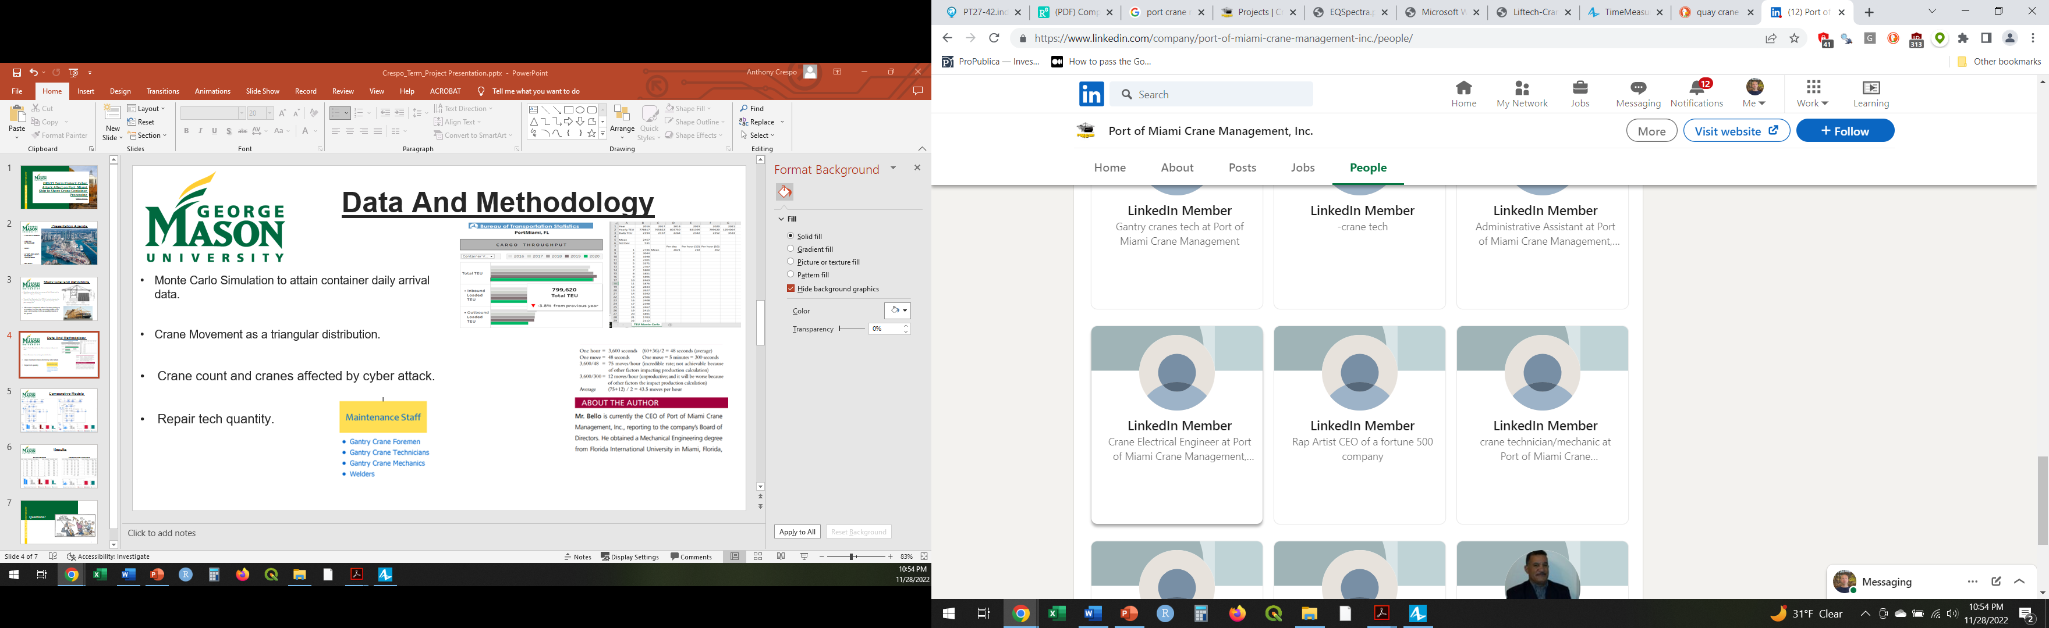
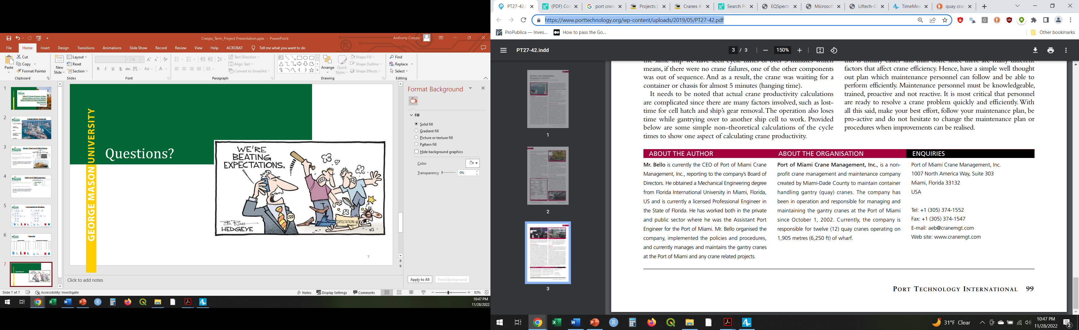
Data And Methodology
Monte Carlo Simulation to attain daily container arrival data.
Crane Movement as a triangular distribution.
Crane count and cranes affected by cyber attack.
Quantity of Repair Techs.

Slide 5
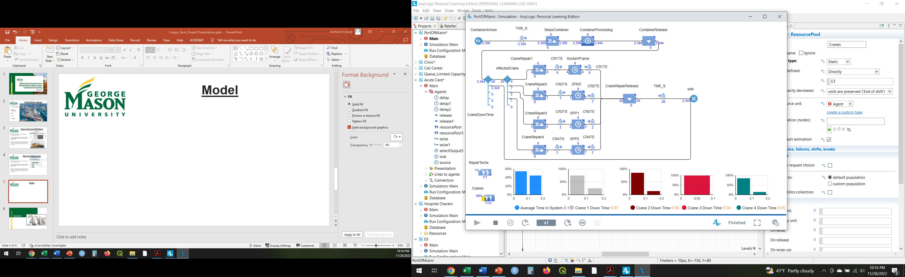
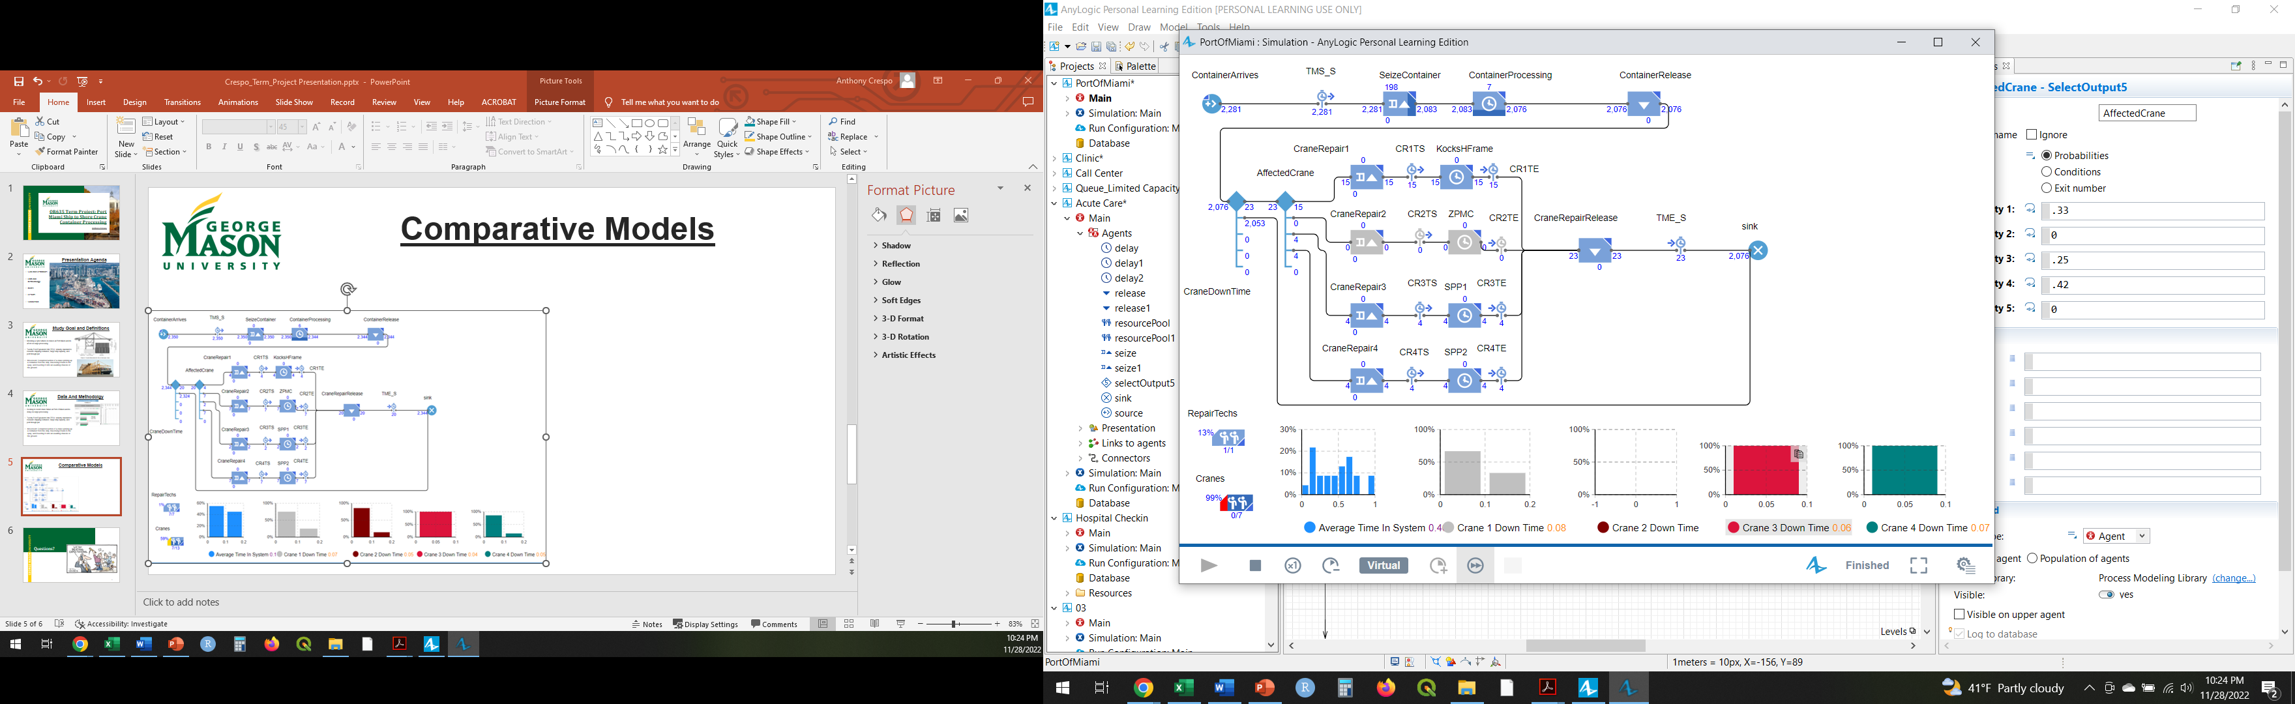
Comparative Models

Slide 6
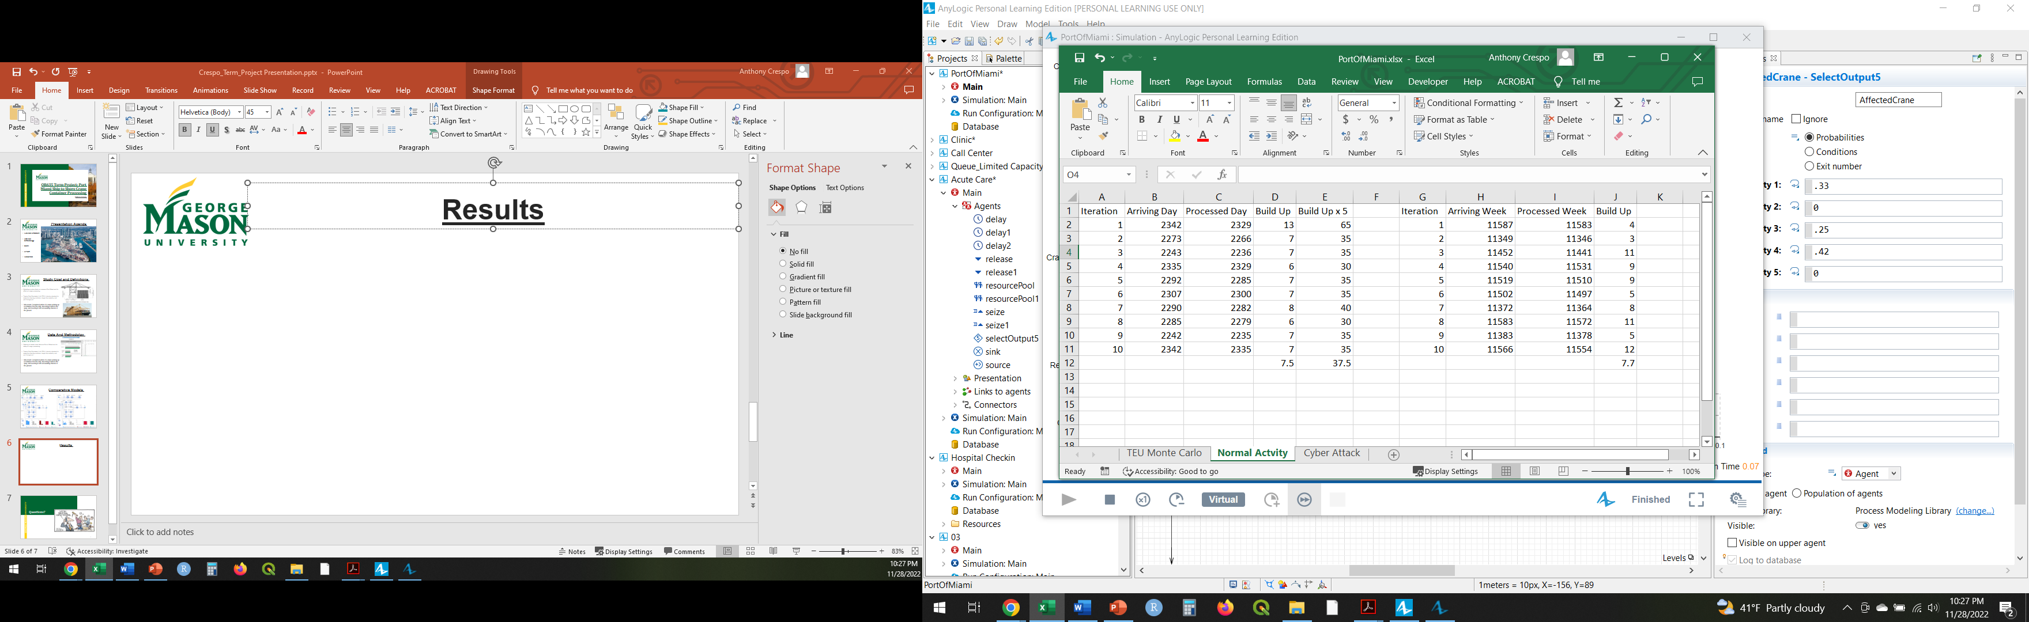
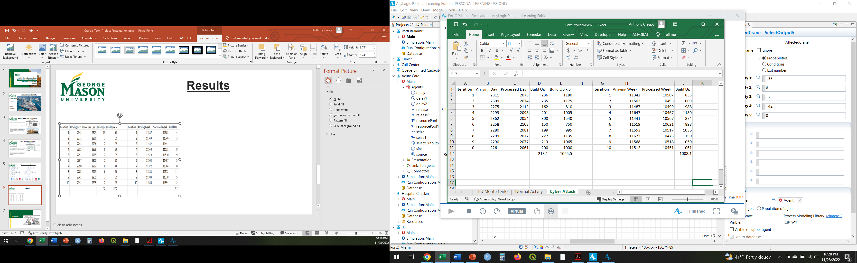
Results and Topics for Further Research
Normal Operations
Operations Under Cyber Attack

Slide 7
Questions?

